Slide 1

Medical AI Research: Predicting postoperative blood transfusion for CABG patients
Capstone Preliminary Presentation, March 19, 2024
Team: Jenny Tsai ¹ & Jichong Wu ¹
Collaborator: Dr. Puneet Gupta ²
Advisor: Professor Amir Jafari ¹
¹ George Washington University
² George Washington University Hospital

Slide 2

Overview
Introduction
Data Preprocessing
Analysis Strategy
Modeling & Results
Summary
Next Steps

Slide 3
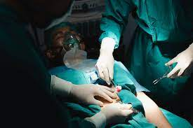
Introduction
1,452 × 966
Coronary Artery Bypass Graft (CABG) is a common cardiac surgery
May cause major bleeding which needs blood transfusion
Blood transfusion is associate with:
Higher risks of mortality after surgery
Higher odds of readmission and heart failure within 30 days

Slide 4

Research Gap
Previous research*:
A single cardiac surgery center in Austria
N = 3782 (2010-2019)
Random Forest:
RUC: 0.76-0.86
In the current project:
US national database ACS NSQIP
N = 8587 (2018-2022)
Basic models + Neural Networks + Feature engineering/selection
*Tschoellitsch et al. (2022)
Notes:
Lots of research has been done to explore factors that can help to predict the need for blood transfusion, but often with limitations. For example…

Slide 5
Objectives
Develop models that can best predict which patients need blood transfusion
Improve patient selection and education
Enhance physician preoperative awareness
Inform periop guidelines for CABG patients
Experiment with different DS techniques (e.g., feature selection, feature engineering, synthetic data) applied in basic and advanced models to achieve best outcomes
Develop a full set of modules that can be reused in the future, which covers preprocessing, feature selection and feature engineering, and modeling
Notes:
Objectives of the our project is three-fold.

Slide 6
Data Preprocessing
Datasets
Participant Use Data File (PUF) on the American College of Surgeons National Surgical Quality Improvement Program (ACS NSQIP)
Year 2018 - 2022 (N = 8587, # of features = 294)
Key preprocessing steps:
Basic clean-up (e.g., recode values, correct data type)
Remove columns with over 50% missing values
Impute with mean (numeric) and most frequent values (categorical)
Standardize all numeric features
Remove post-operative and irrelevant features by expert
Final dataset size:
N = 8587, # of features = 41

Slide 7
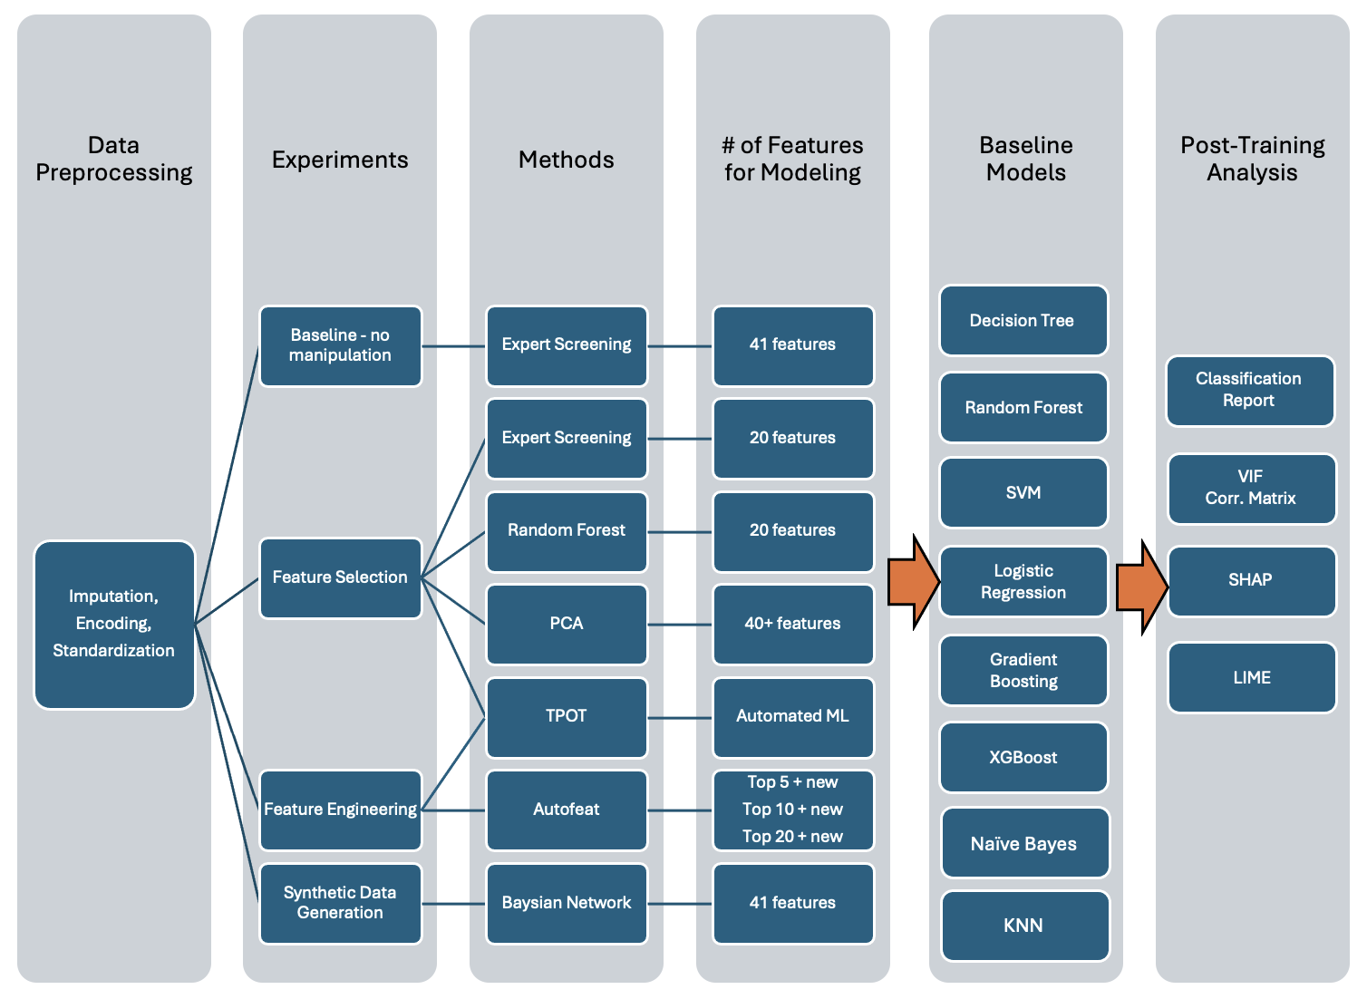
Analysis
Strategy

Slide 8
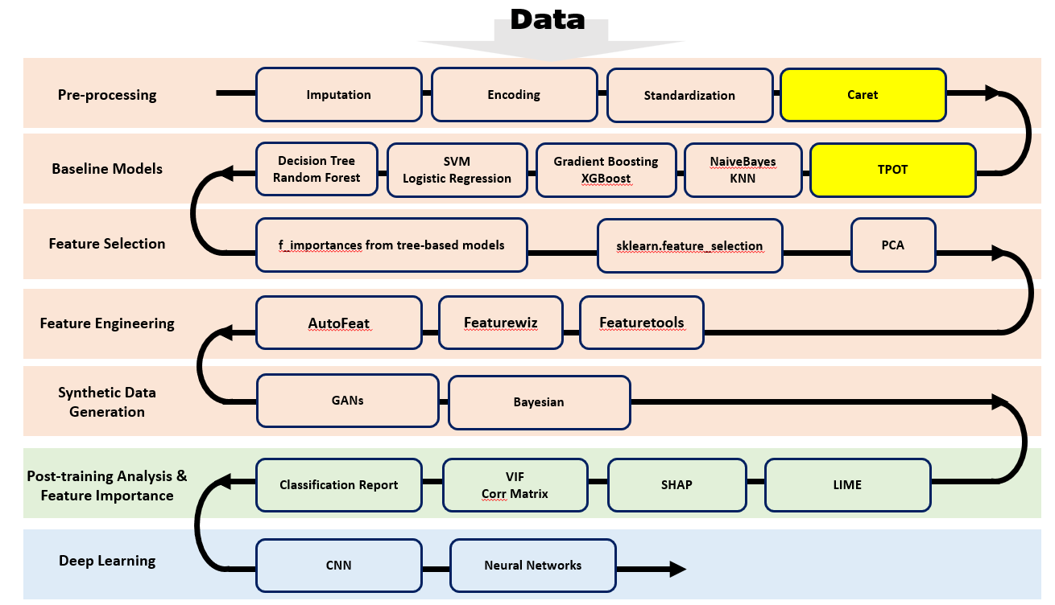
Analysis Strategy
Notes:
Please remove GANs as Prof. says it’s not easy to train and is not as powerful as realtabformer.

Slide 9
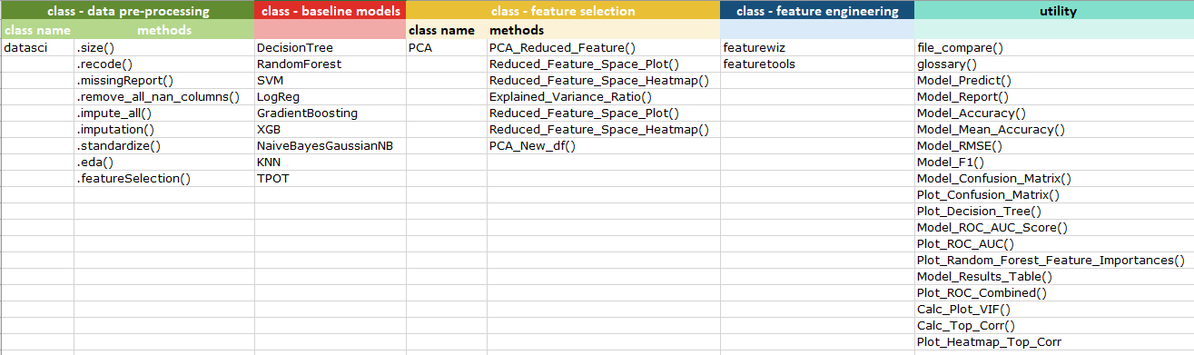
Modules and Utilities

Slide 10
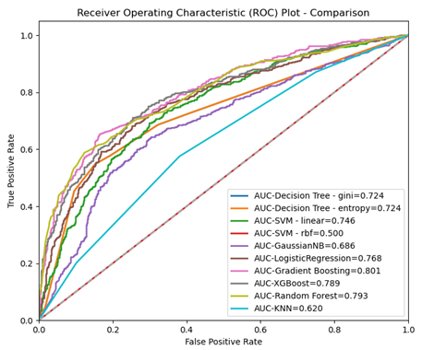
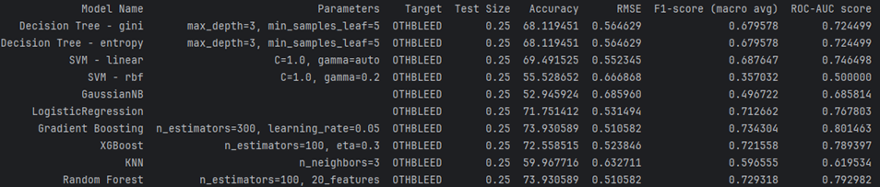
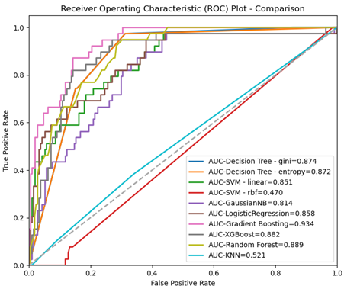
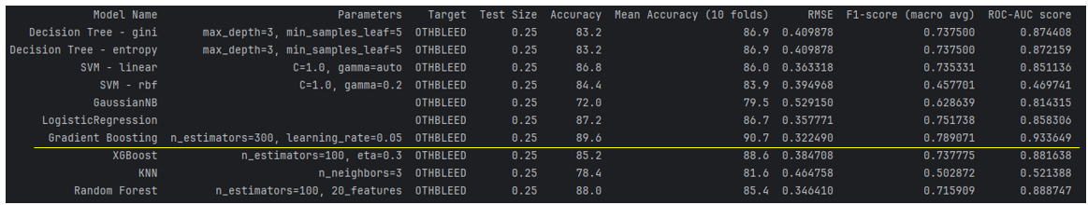
Model Results

Slide 11
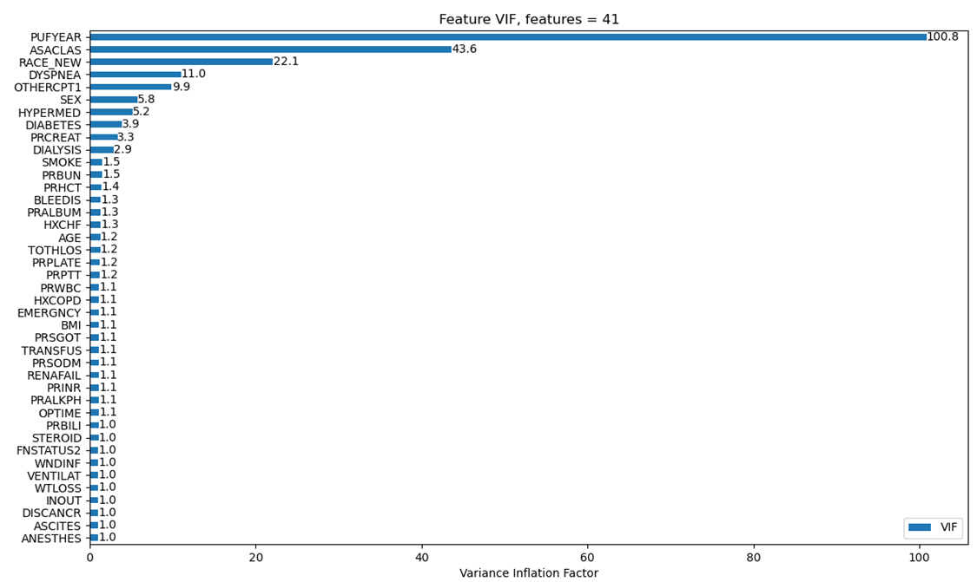
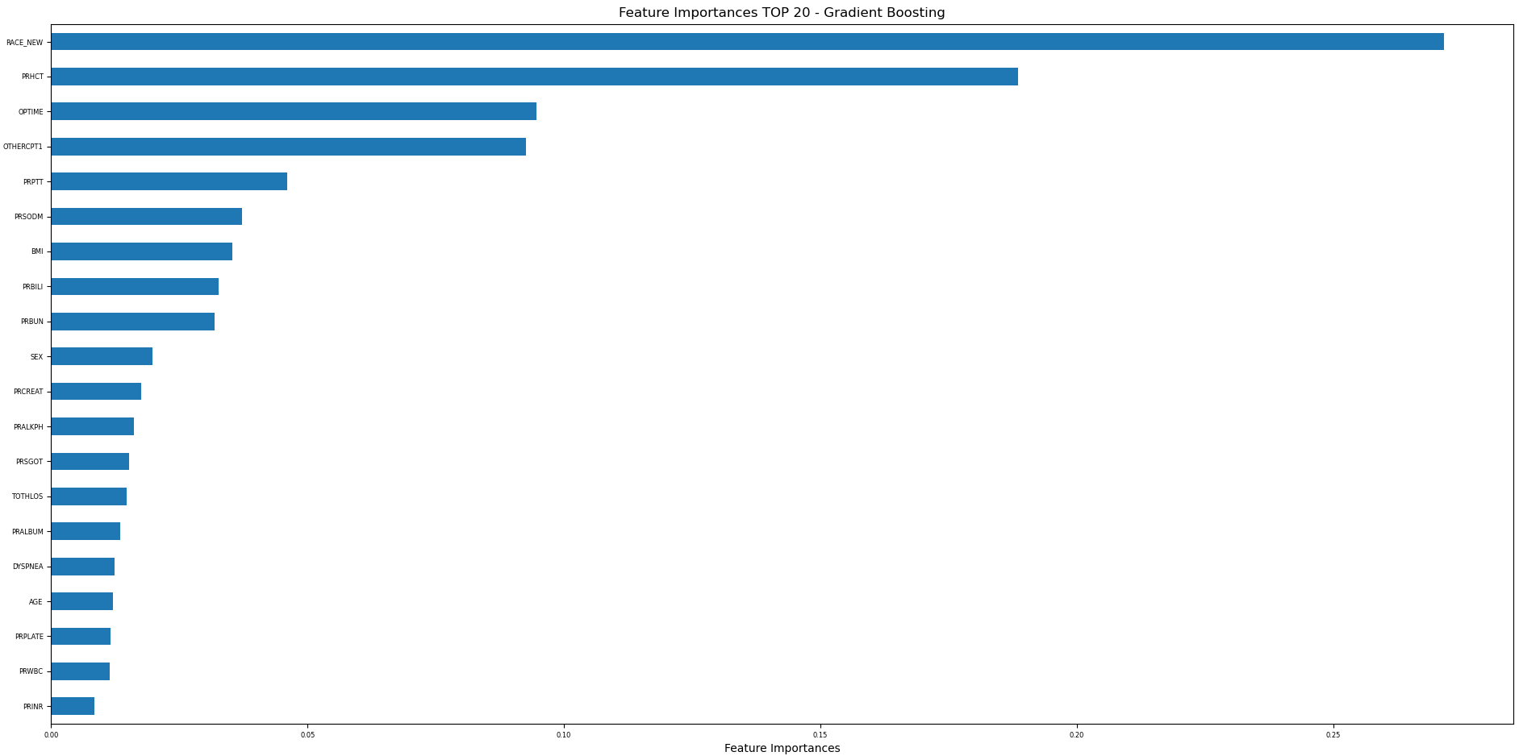
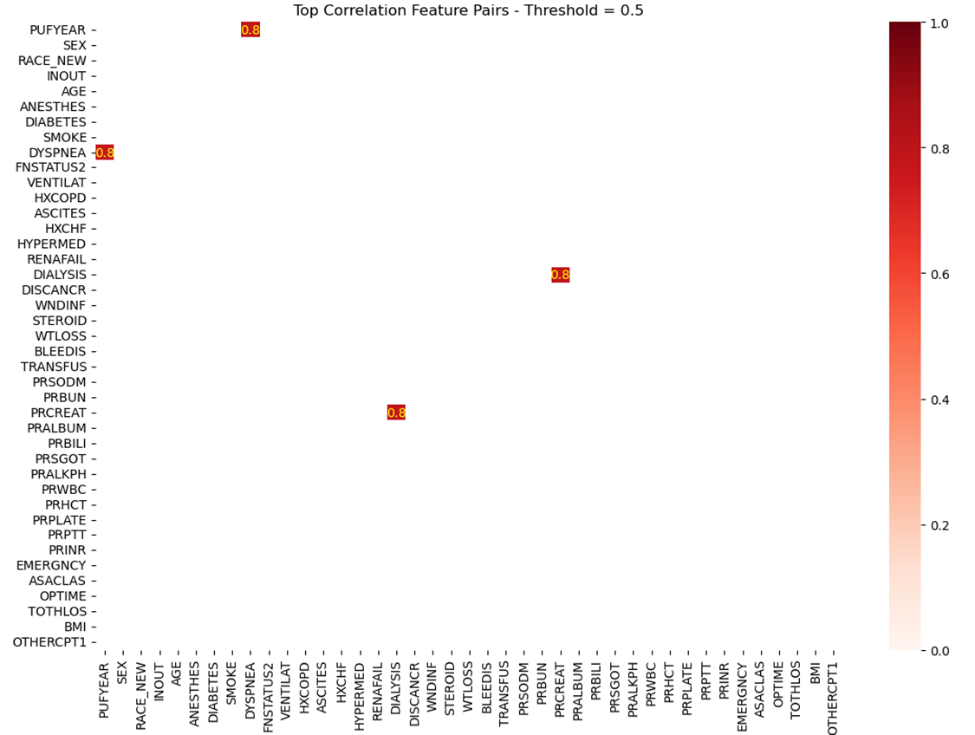
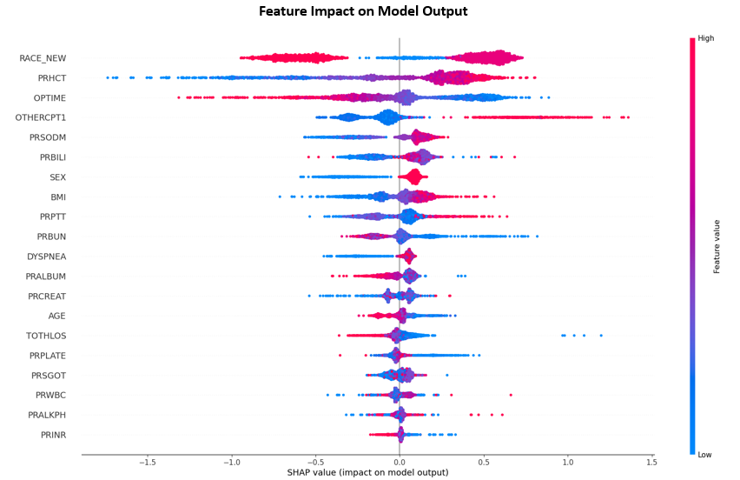
Post-training Analysis

Slide 12
Conclusions
PUFYEAR, ASACLAS, RACE_NEW may cause multicollinearity.
Gradient Boosting, XGBoost, Random Forest perform the best.
Synthetic data generation techniques (DataSynthesizer using Bayesian networks) significantly improve model performance.
Race, days from preoperative labs to operation, operation time, other procedure, BMI, sex, length of hospital stay, shortness of breath, age, preoperative blood test measures
days from preoperative labs to operation, operation time may have a negative impact on model results while other procedure, BMI have a positive effect.

Slide 13
Next Steps
Improve model performance by:
Add more samples (older datasets from 2015-2017)
Recategorize target variable (intra vs. postop blood transfusion)
Other ways to generate synthetic data (e.g., realtabformer)
Conduct post-training analysis (continued) to study impacts of features to model performance
Neural networks (e.g., CNN, transformers)

Slide 14

Thank You!

